Slide 1
crypto++

Slide 2
Install crypto++
sudo apt-get update
sudo apt-get install libcrypto++-dev libcrypto++-doc libcrypto++-utils
Include in CmakeLists.txt (hard way)
cmake_minimum_required(VERSION 3.5)
project(Demo)
# Specify the include and library directories for Crypto++
include_directories(usr/include/crypto++)
link_directories(usr/lib/x86_64-linux-gnu)
# Add your executable and link with Crypto++ library
add_executable(myExecutable main.cpp)
target_link_libraries(myExecutable crypto++)

Slide 3
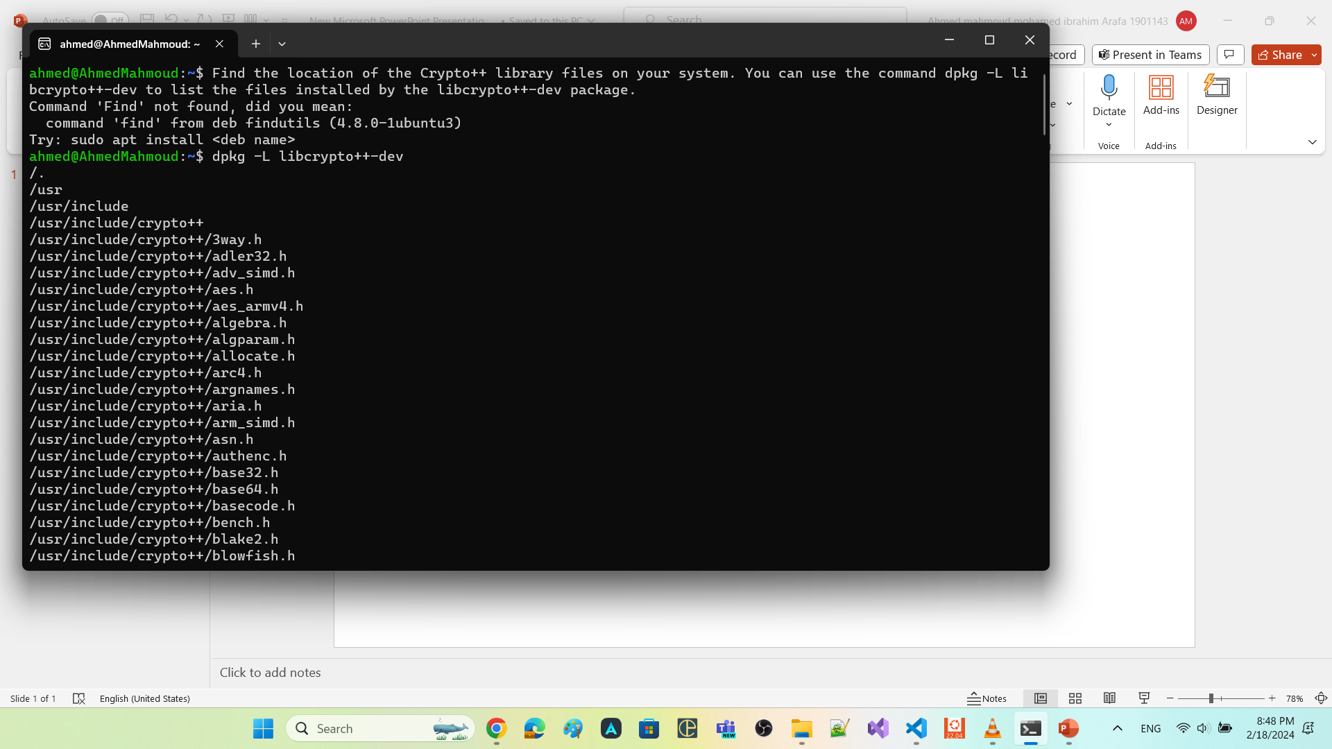

dpkg -L libcrypto++-dev

Slide 4
Include in CmakeLists.txt (soft way)
Create a FindCrypto++.cmake file with the following content:
find_path(Crypto++_INCLUDE_DIR cryptopp)
find_library(Crypto++_LIBRARY NAMES cryptopp)
set(Crypto++_FOUND TRUE)
if(NOT Crypto++_LIBRARY OR NOT Crypto++_INCLUDE_DIR)
set(Crypto++_FOUND FALSE)
endif()
if(Crypto++_FOUND)
set(Crypto++_LIBRARIES ${Crypto++_LIBRARY})
set(Crypto++_INCLUDE_DIRS ${Crypto++_INCLUDE_DIR})
endif()

Slide 5
Update your CMakeLists.txt file with the following content:
cmake_minimum_required(VERSION 3.5)
project(Demo)
# Include the directory containing FindCrypto++.cmake
set(CMAKE_MODULE_PATH ${CMAKE_MODULE_PATH} ${CMAKE_CURRENT_SOURCE_DIR})
# Find the Crypto++ package
find_package(Crypto++ REQUIRED)
# Add your executable and link with Crypto++ library
add_executable(myExecutable main.cpp)
target_include_directories(myExecutable PUBLIC ${Crypto++_INCLUDE_DIRS})
target_link_libraries(myExecutable ${Crypto++_LIBRARIES})
Place the FindCrypto++.cmake file in the same directory as your CMakeLists.txt file

Slide 6
Security Concepts

Slide 7
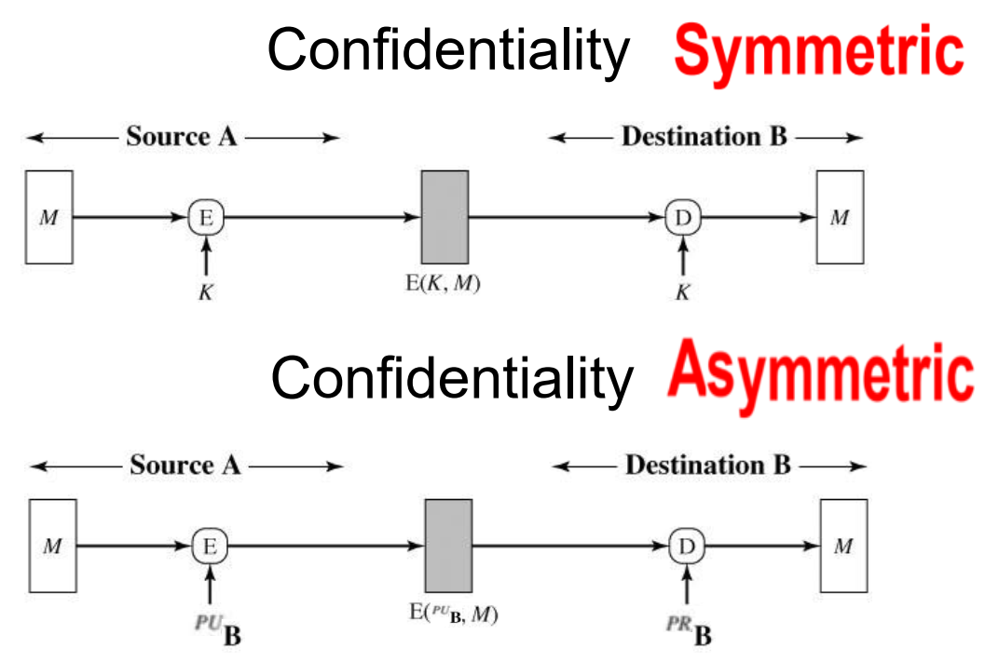
Use case
prevents unauthorized access to sensitive information.

Slide 8
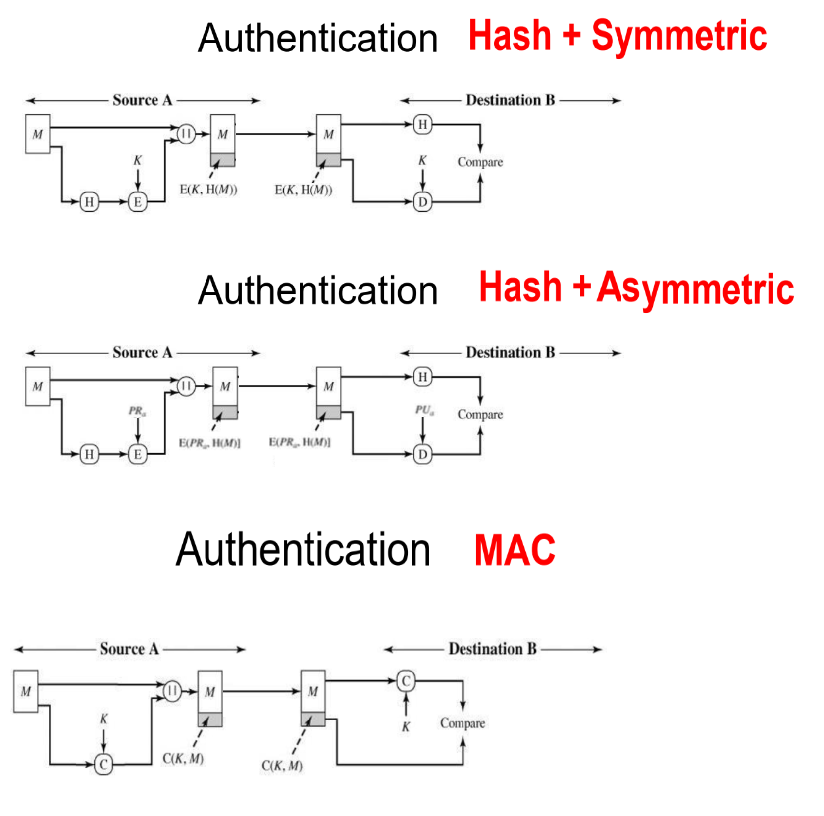
Use case at which we recommend authentication over encryption of plaintext
plaintext is large book
I want to ensure that no one edit it during transmission.
it is okay if anyone could read it

Slide 9
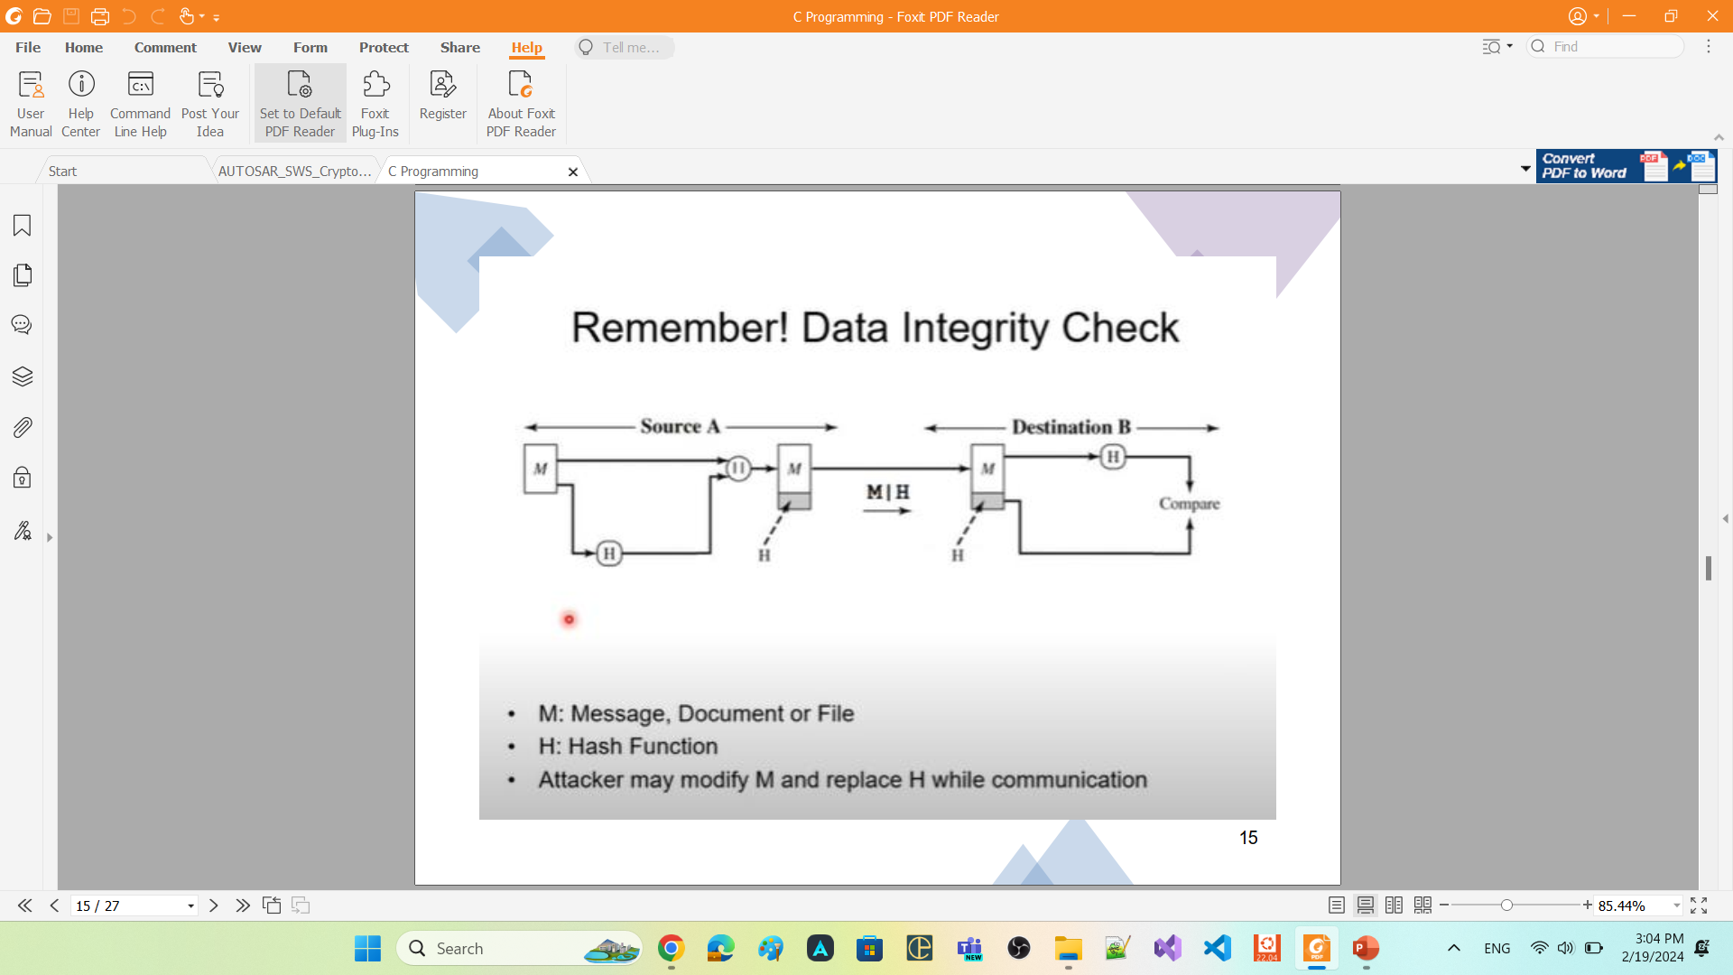
Use case
When we want to store data in the memory, and we want to sure that no one have modify this data

Slide 10
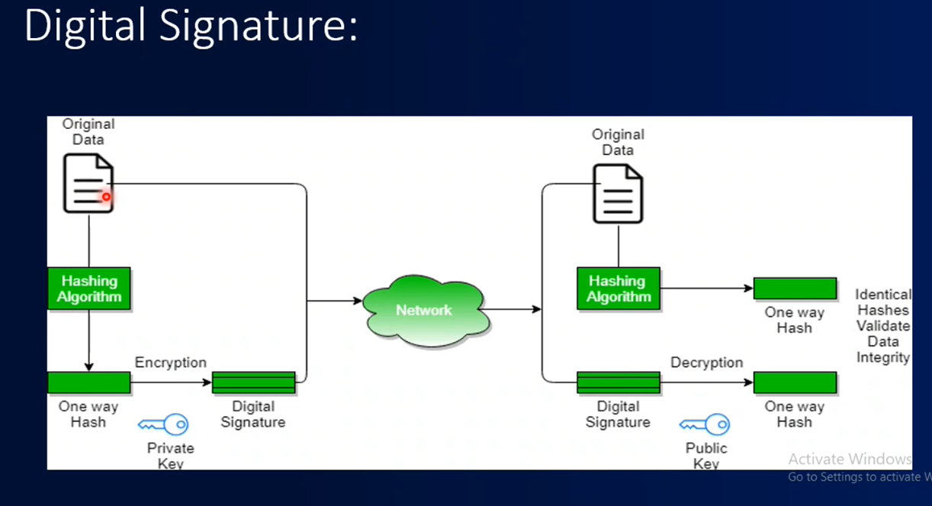

Slide 11
FC Crypto

Slide 12
FC Crypto
foundation functional cluster.
offers applications and other Adaptive AUTOSAR Functional Cluster a standardized interface (CryptoAPI) for
access multiple implementations of cryptographic operations
key management
certificate handling.
supports
symmetric-key cryptography.
both public-key cryptography
CryptoAPI provides a set of methods which enable application and system developer to
store and transmit information while safeguarding it from intruders.
keep critical information in confidential and / or authentic form
communicate in a way such that only the intended recipient can read the message
FC Crypto
provides mechanisms for applications that ensure the following security goals:
Authentication: FC Crypto provides mechanisms that allow adaptive applications or functional clusters to prove their identity to other applications or functional clusters.
Confidentiality: FC Crypto allows to keep information private. encryption can assure that only users who have access to the appropriate key will get read access to the data plaintext.
Integrity: FC Crypto ensures that secured data is not altered during storage or transmission without the receiver detecting this altering

Slide 13
The FC Crypto
mediates for Adaptive Application and Functional Cluster access and usage of secret key material
The Adaptive Application and Functional Cluster should not have direct access to keys within its own process.
verifies whether an application or functional cluster is allowed to access a specific cryptographic object, which is stored in the infrastructure of the FC Crypto.
This access control mechanism is realized in combination with IAM, where the FC Crypto acts as a policy enforcement point.

Slide 14
Crypto API

Slide 15
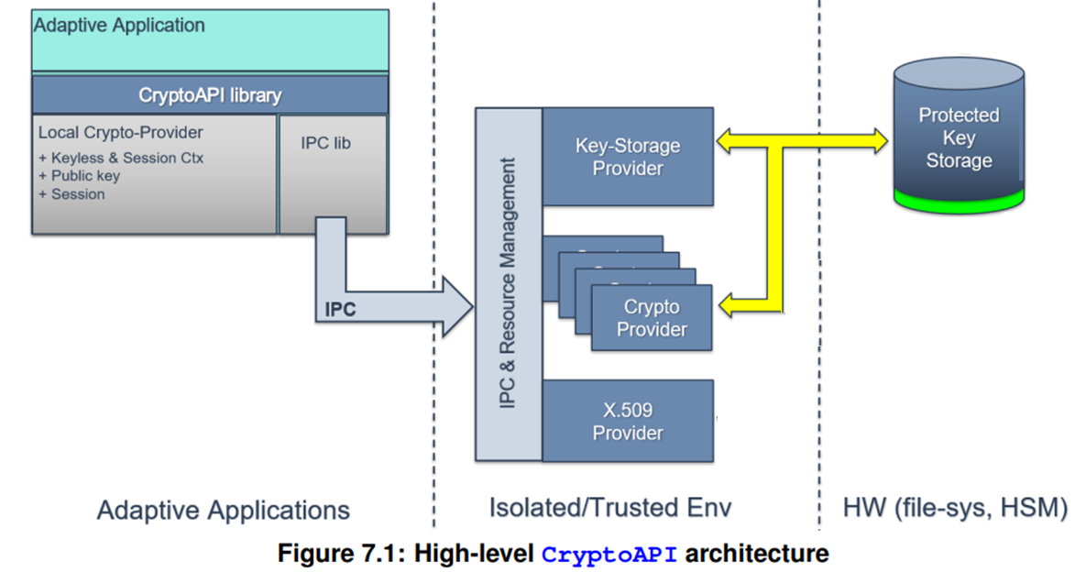
Crypto API is divided into the following sub-parts:
Key Storage Provider.
One or more Crypto Provider
X.509 Certificate Management
Provider
each of provider implements specific domain
of cryptography-related functionality

Slide 16
CryptoAPI provided by FC Crypto to consumers is presented by three different Provider types, each of them implements specific domain of cryptography-related functionality:
1. CryptoProvider (CP, namespace ara::crypto::cryp)
responsible for implementation of all supported cryptographic primitives.
FC Crypto may support multiple instances of the CryptoProviders.
Each instance of CryptoProvider represents single holistic software- or hardware-based implementation of some set of cryptographic algorithms.
2. Key Storage Provider (KSP, namespace ara::crypto::keys)
responsible for secure (confidential and/or authentic) storage of different type key material (public/private/secret keys, seeds) and other security critical cryptographic objects (digital signatures, hash, MAC/HMAC tags).
CryptoAPI consumers work with logically single KSP that is used for access to all crypto objects

Slide 17
Crypto Provider

Slide 18
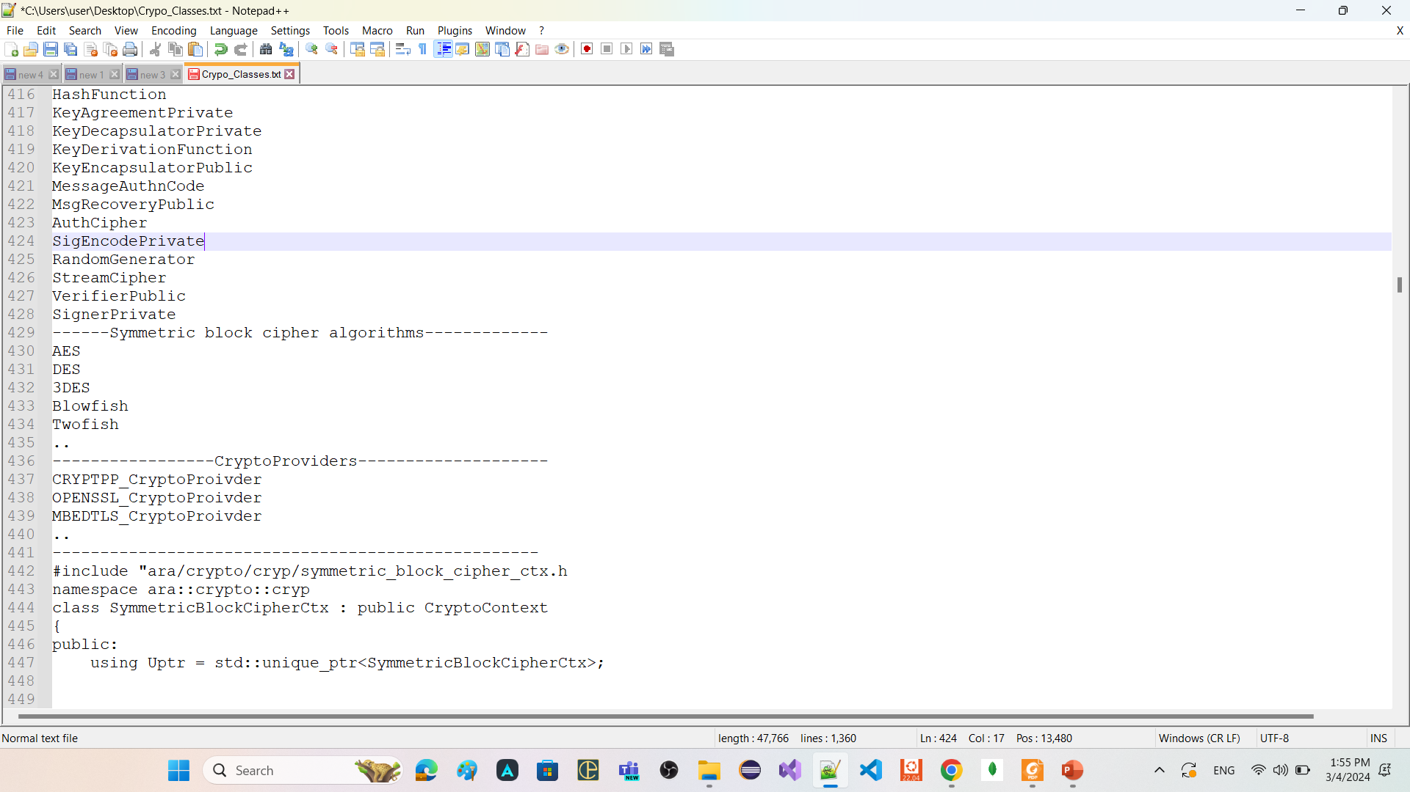
FC Crypto allow to use software libraries like
Crypto++
Openssl
Mbedtls
…
Crypto Provider standardize the APIs that should be use to preform cryptographic operations
Crypto Provider is a structural element that organizes cryptographic primitives (algorithms).
Every Crypto Provider instance represents exactly a cryptographic library.
at least one Crypto Provider for software element that is available in a project specific environment

Slide 19



Crypto Provider class == CrpytoProviderFactory
doesn't have constructor inside its public scope
Any instance of it can be used to preform cryptographic operations
CyptoPP_CryptoProvider or OpenSLL_CryptoProvider or Mbedtls_CryptoProvider also doesnot have constructor inside their public scope
CryptoProvider
CyptoPP_CryptoProvider
OpenSLL_CryptoProvider
Mbedtls_CryptoProvider

Slide 20
Crypto Object

Slide 21
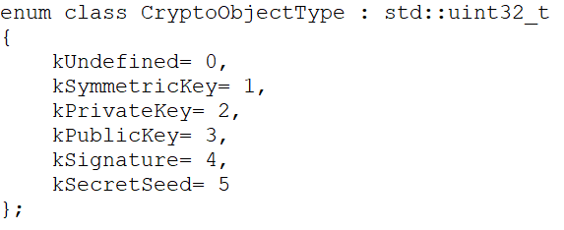

Slide 22
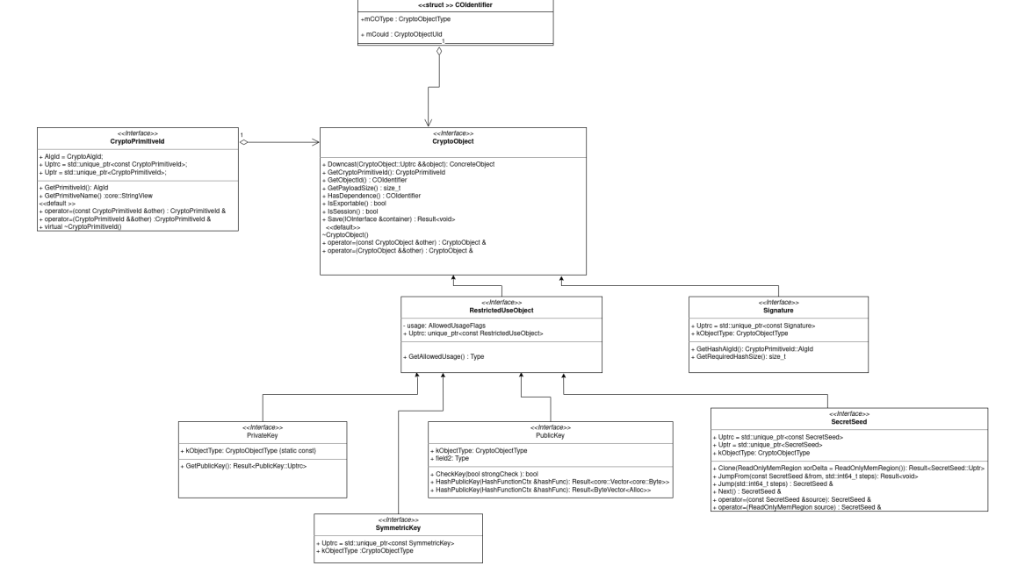

Slide 23
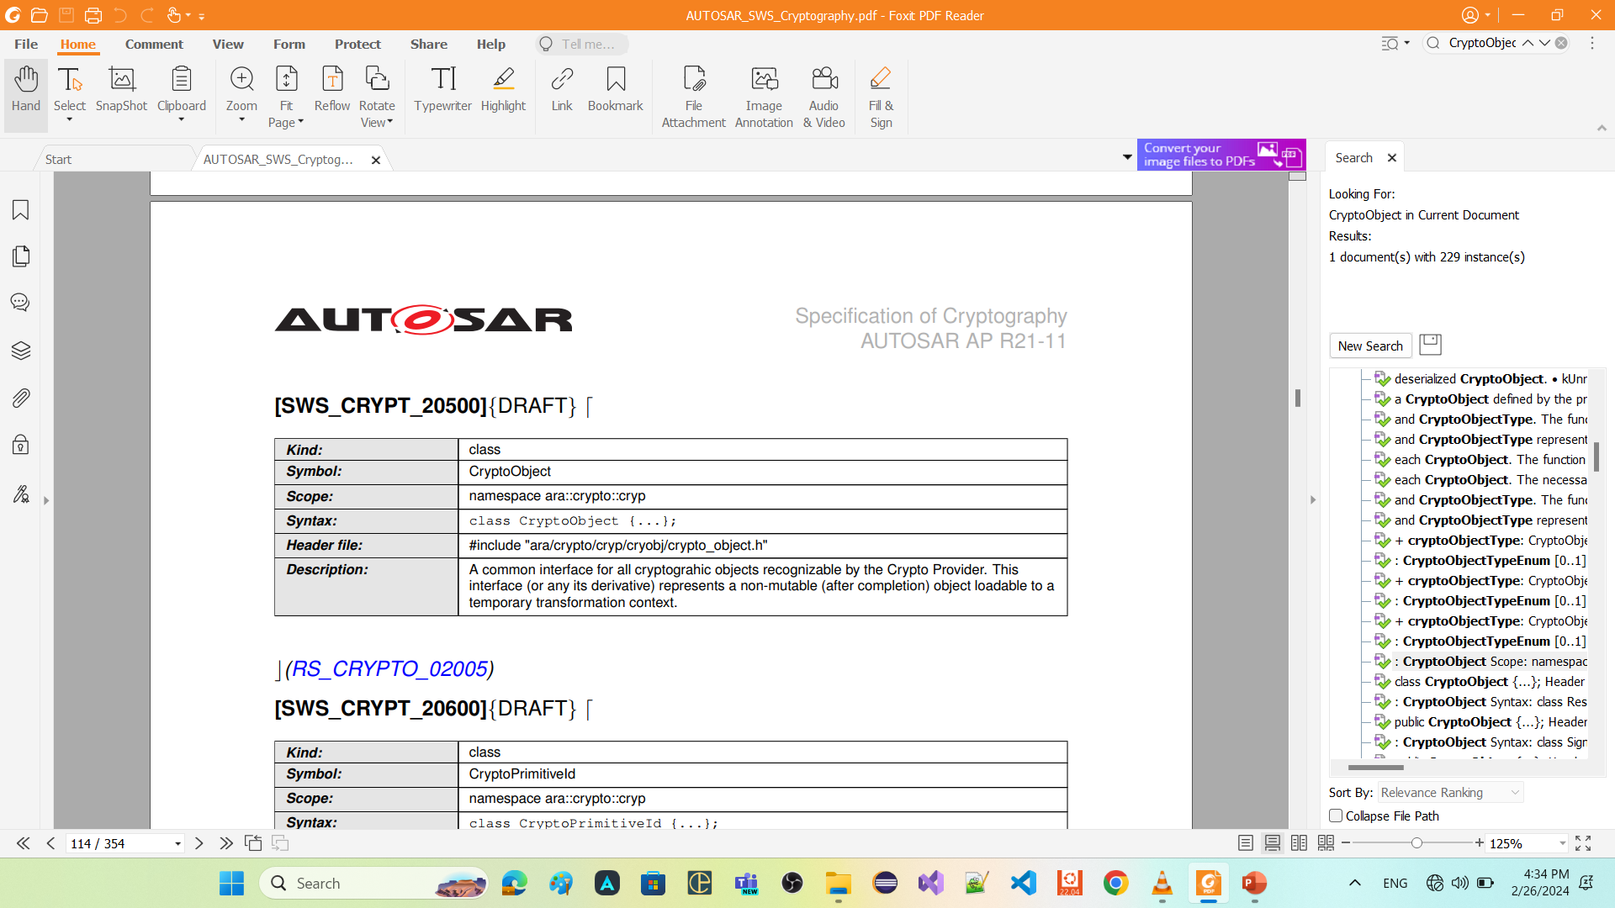

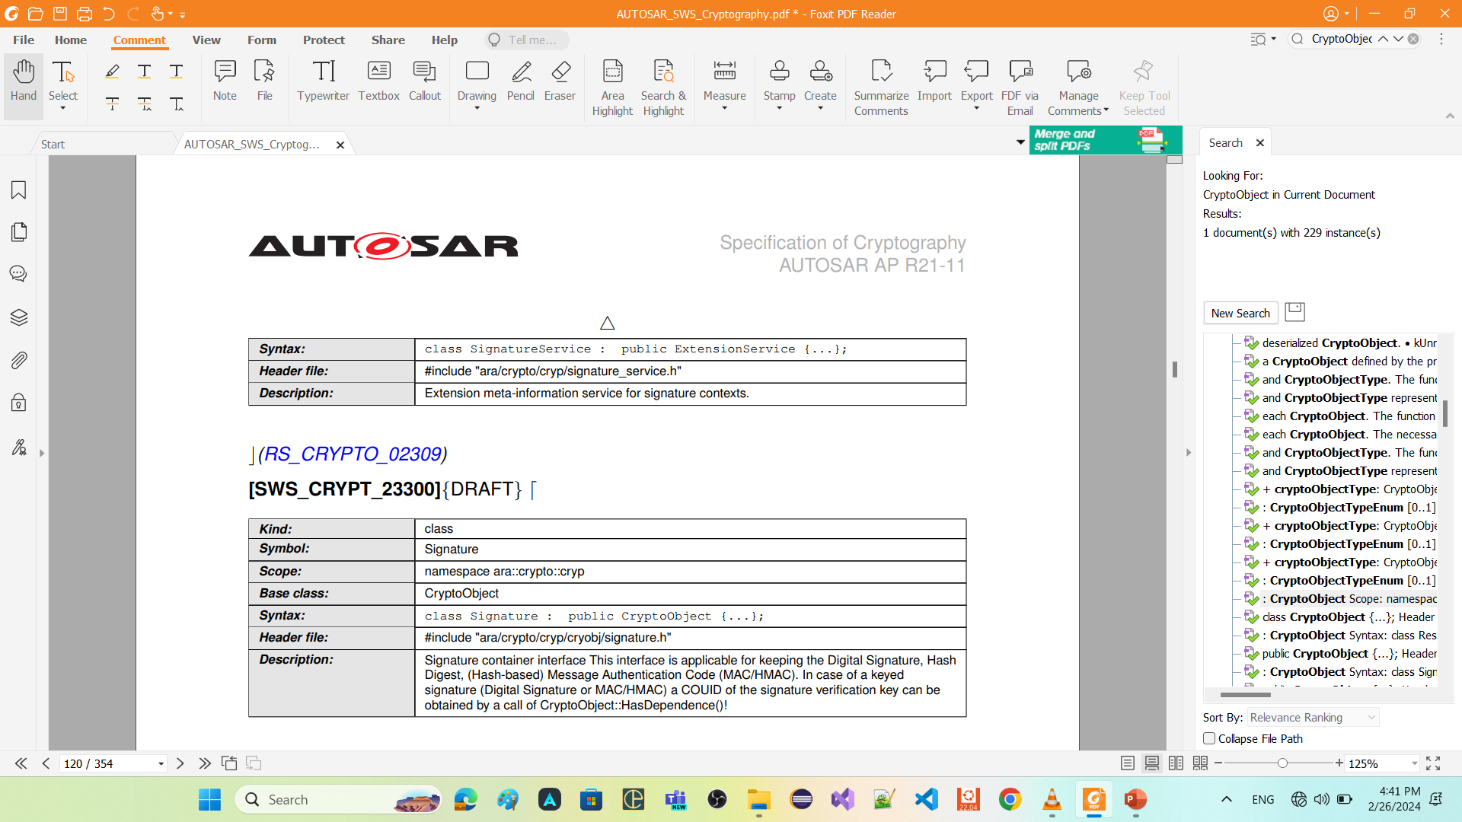
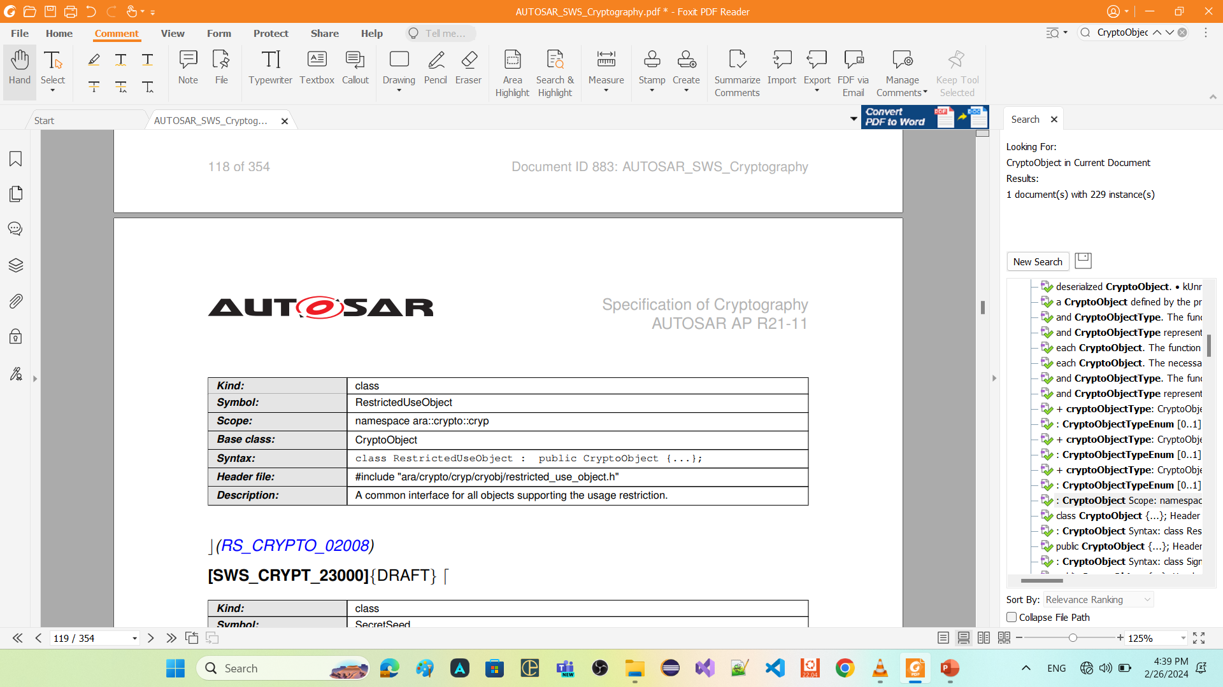
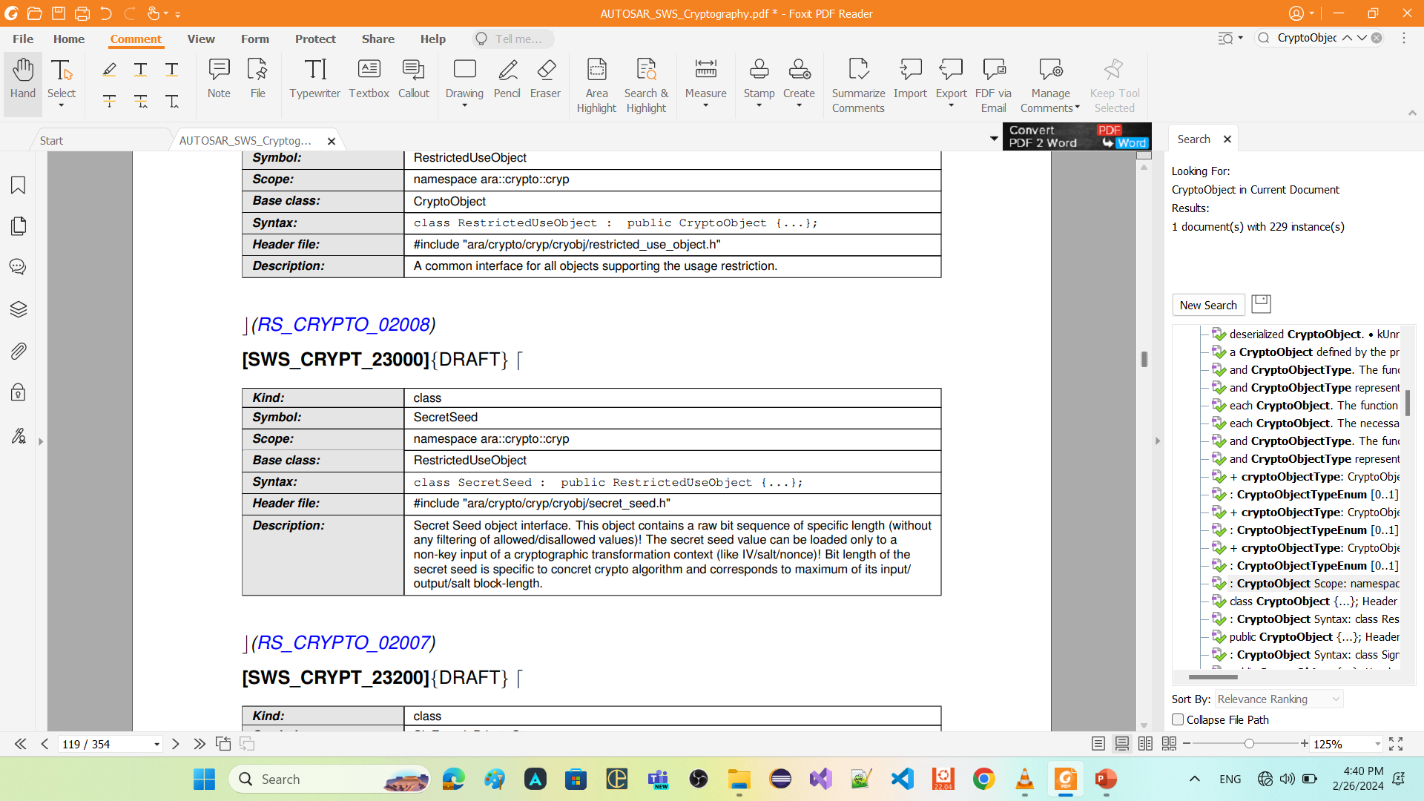
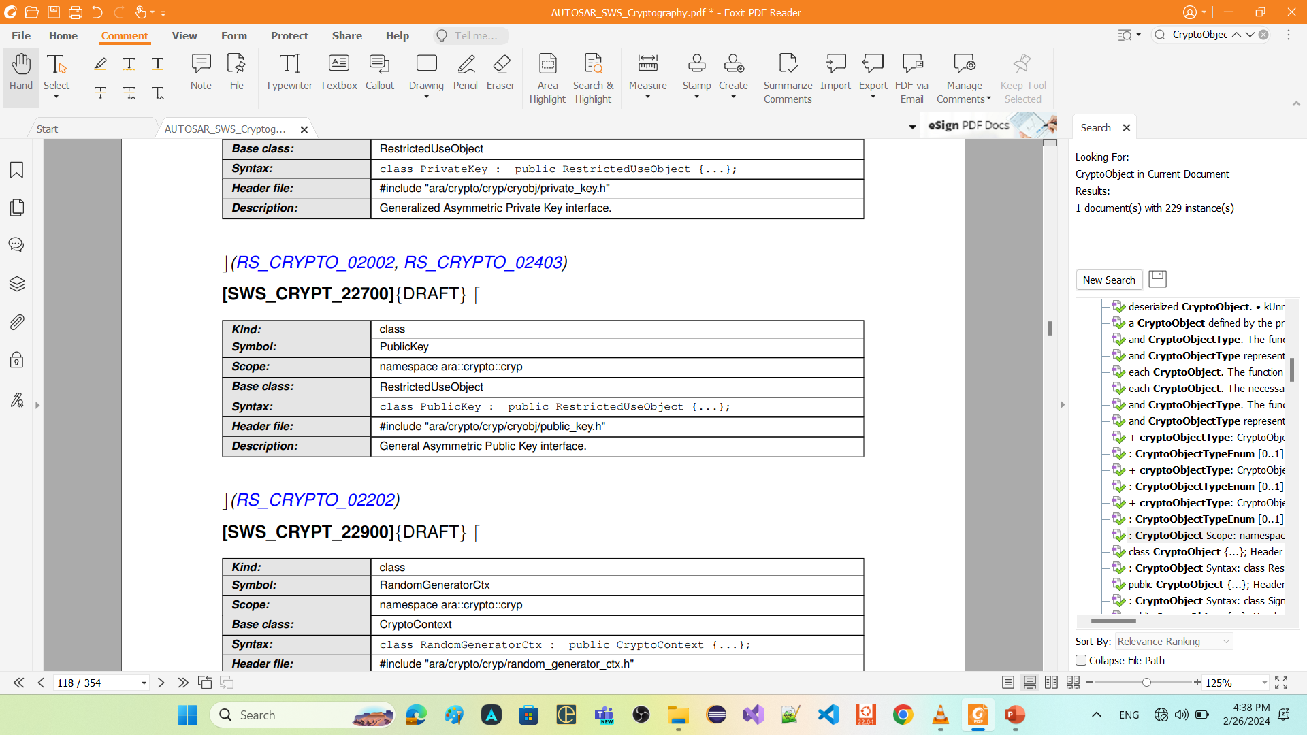
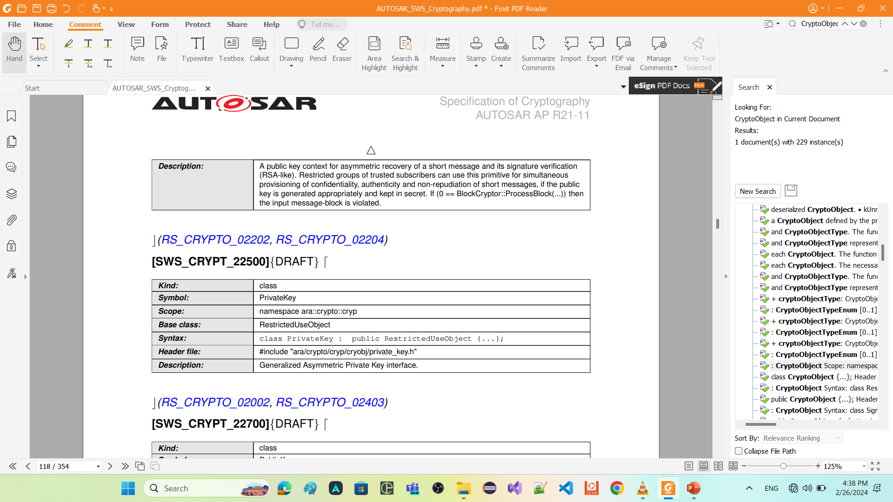












Slide 24
entry_point

Slide 25
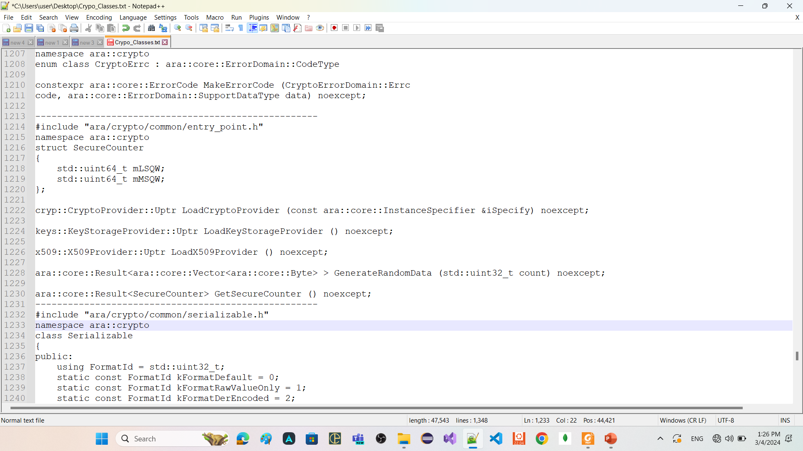

Slide 26
contexts

Slide 27
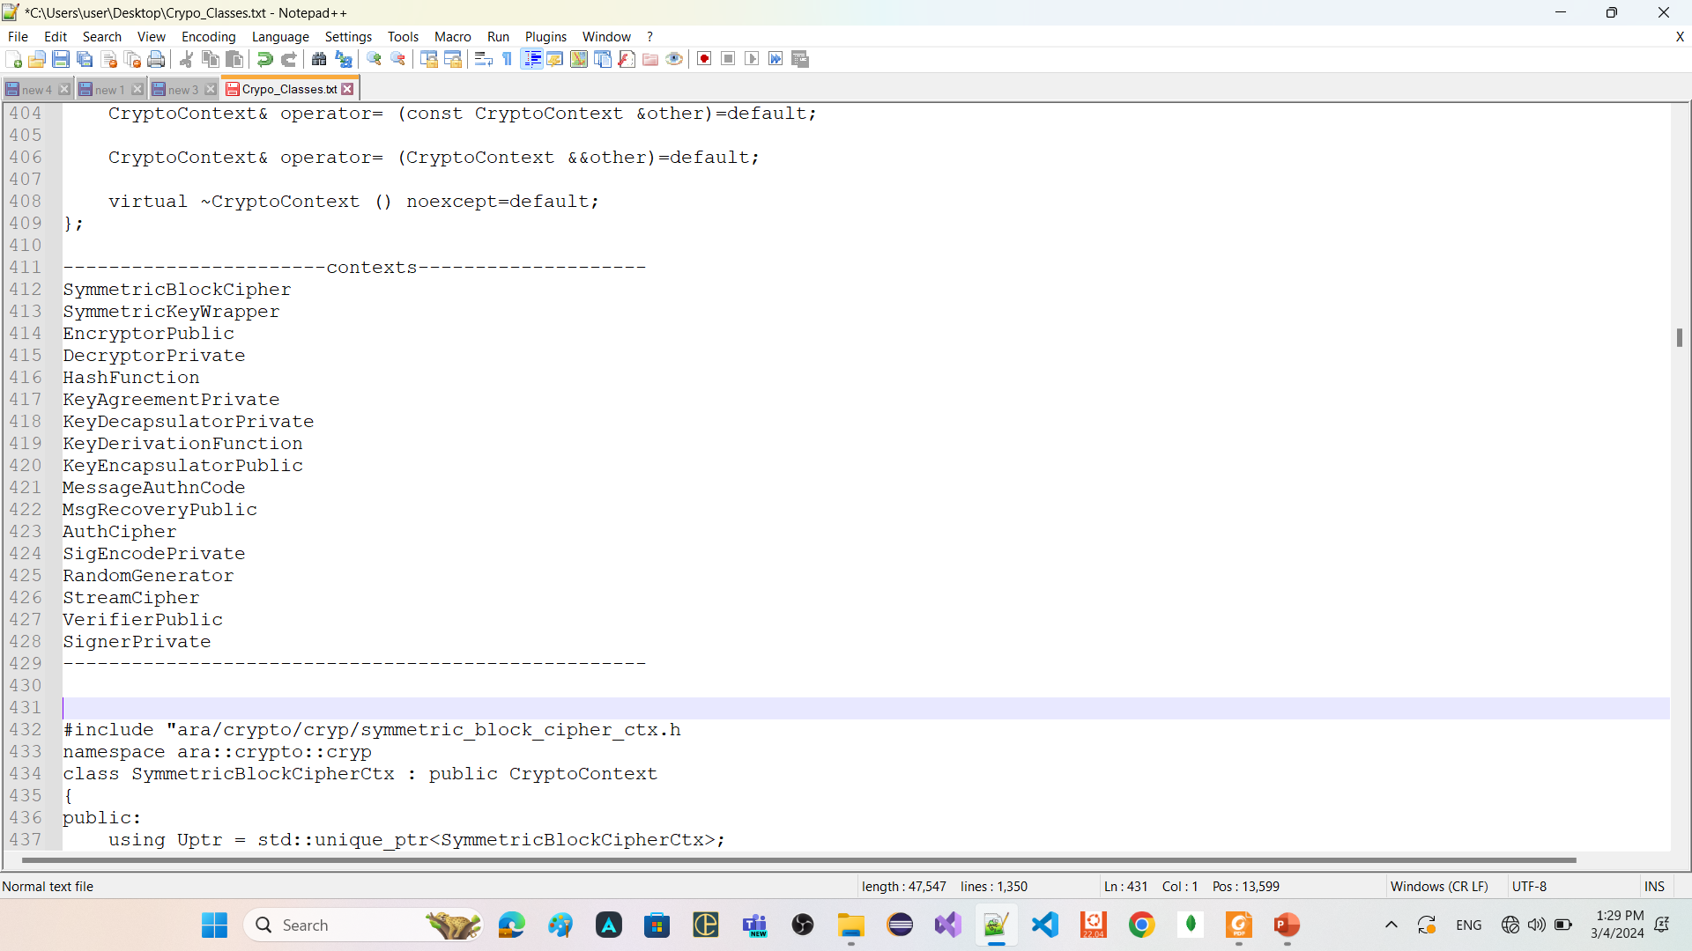
context refers to a data structure or object that encapsulates the state and parameters required for a specific cryptographic operation.

Slide 28
Key1
Key2
Key3
Key4
context
context
context
context
context
context
3DES
DH
context
context
context
context
AES
RSA
context
context
context
context
context
DES
Hash
CryptoProvider

Slide 29
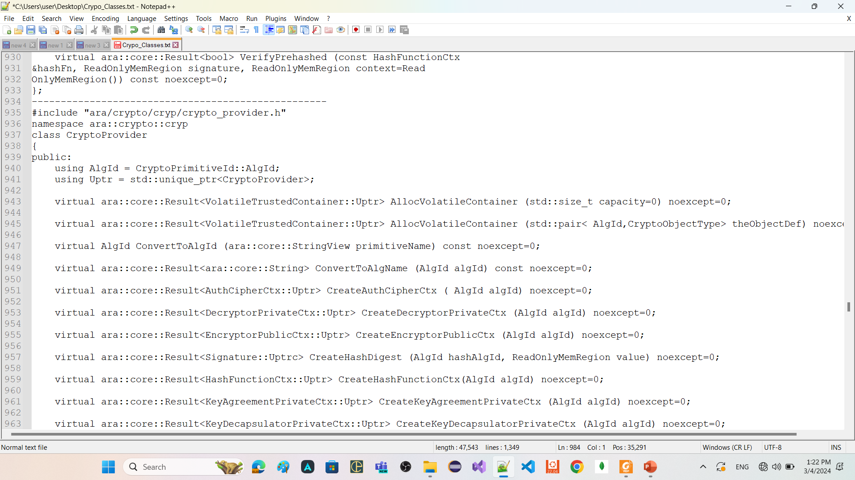
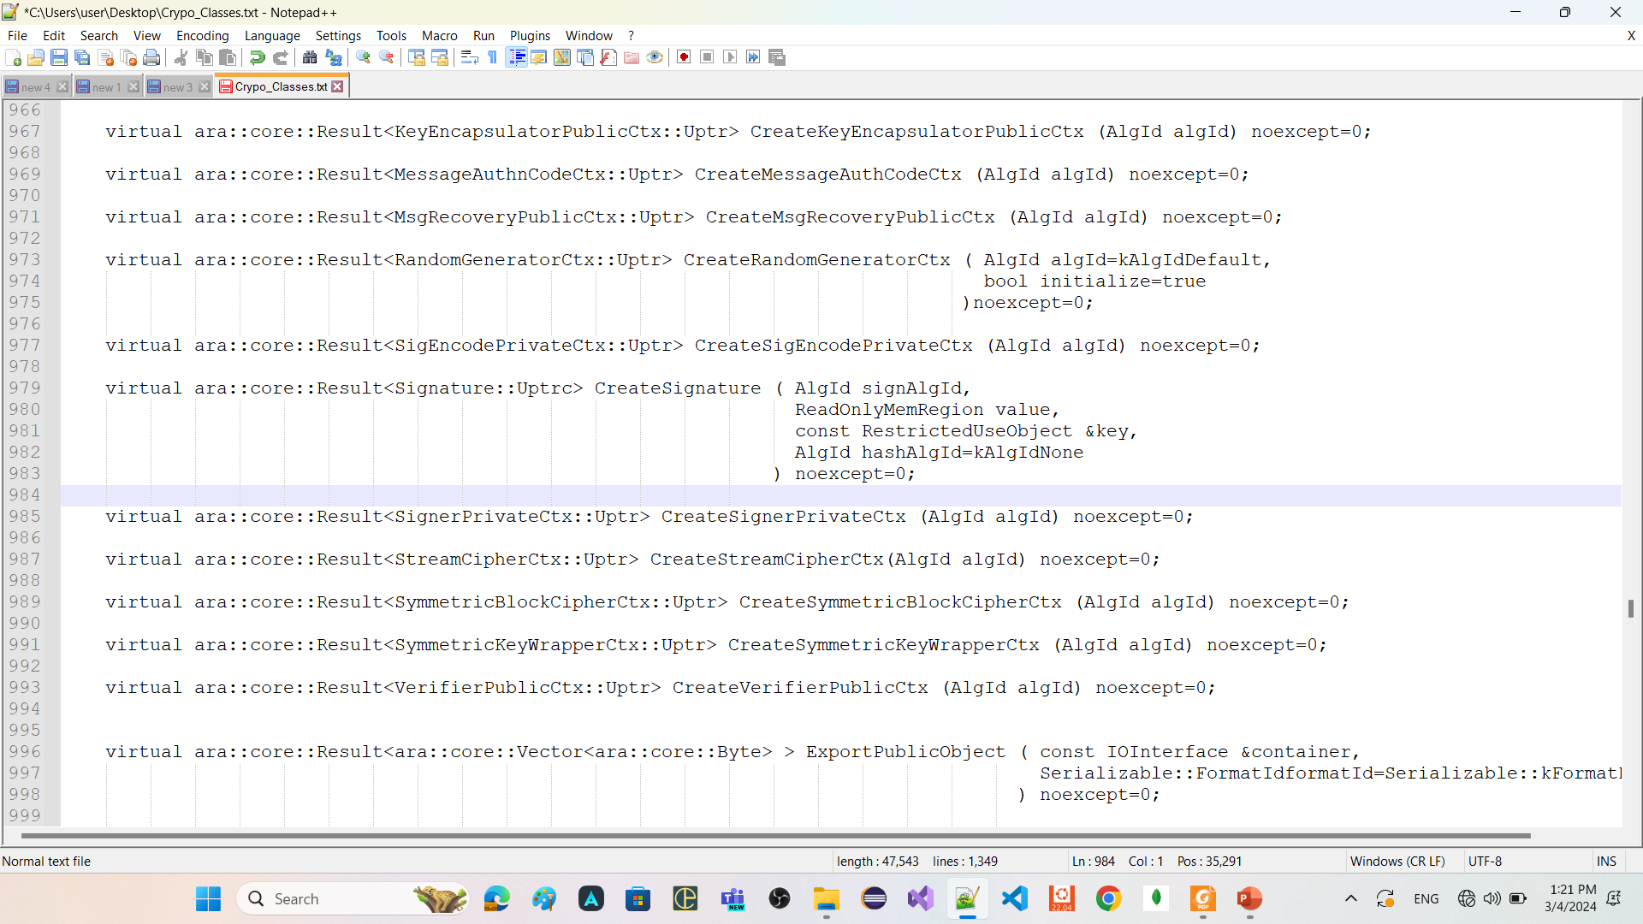
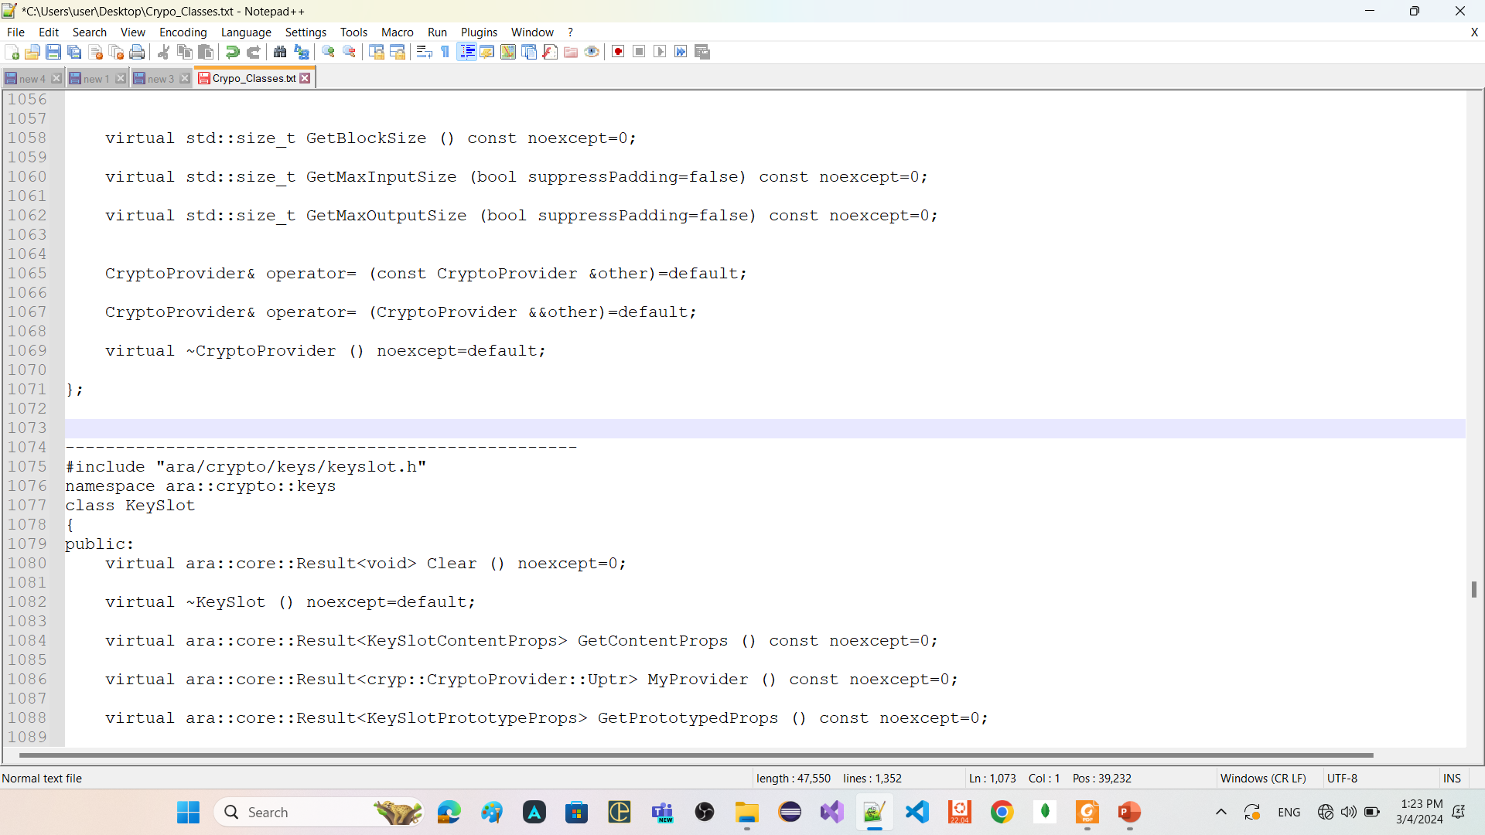
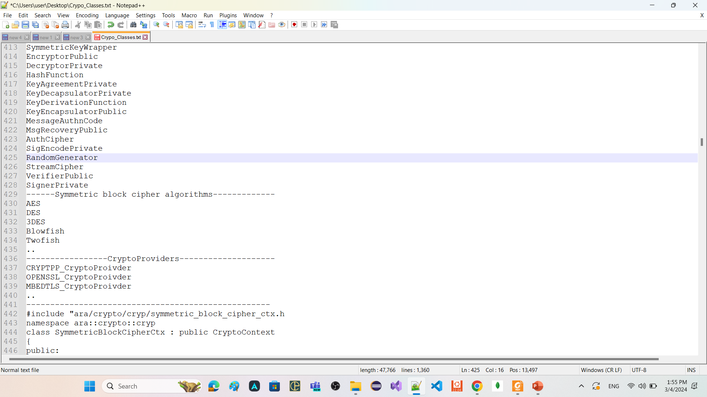

Slide 30
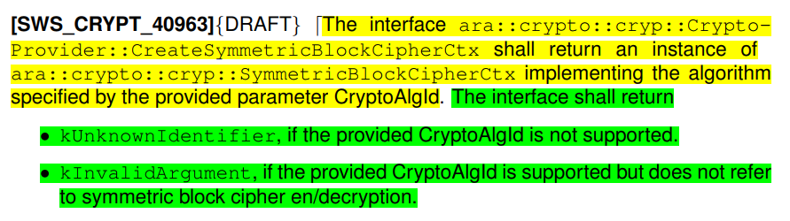

Slide 31
SymmetricBlockCipherCtx
is related only one algorithm of Symmetric block cipher algorithms
has member functions
SetKey
Takes object of class CryptoTransform
To configure this context is for encryption or decryption
Takes object of class SymmetricKey
GetTransformation
return the CryptoTransform that was provided in the last valid call to SetKey.
GetCryptoService
return a unique pointer to CryptoService associated with this context.
ProcessBlock
apply the configured transformation (encryption or decryption) to the provided ReadOnlyMemRegion (container of elements) (span) and return the result.

Slide 32


Slide 33
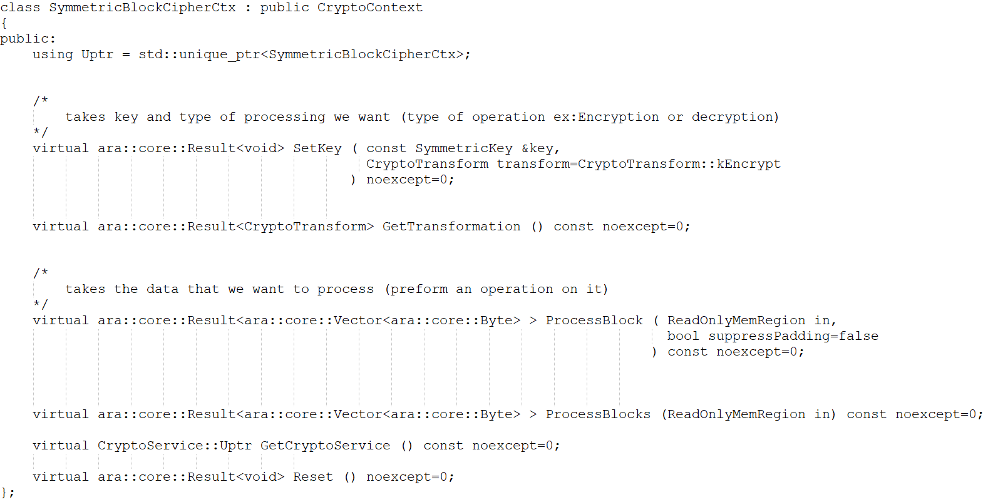

Slide 34
example on using FC crypto

Slide 35

































Slide 36
Symmetric Encryption and decryption
------------------------------------------
CreateSymmetricBlockCipherCtx
LoadSymmetricKey
------------------------------------------
Asymmetric Encryption and decryption
---------------------------------------
CreateEncryptorPublicCtx
CreateDecryptorPrivateCtx
LoadPublicKey
LoadPrivateKey
----------------------------------------

Slide 37
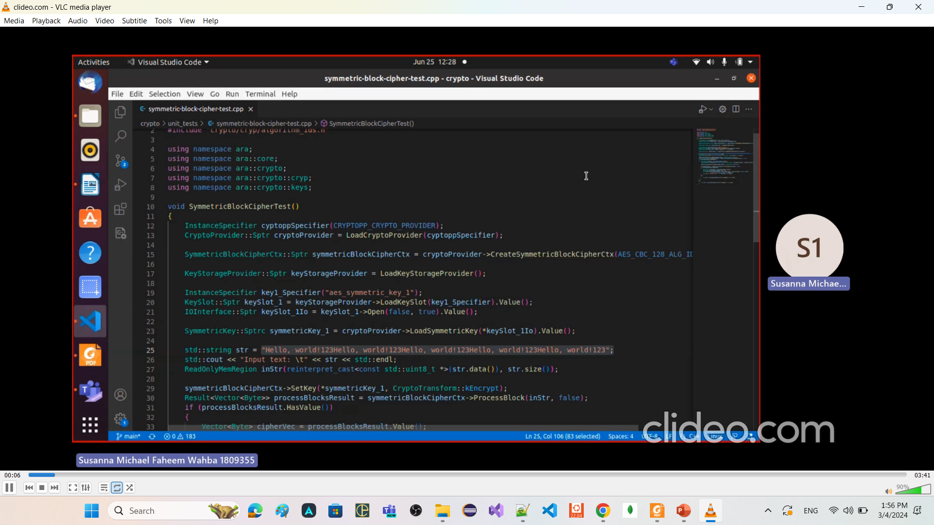
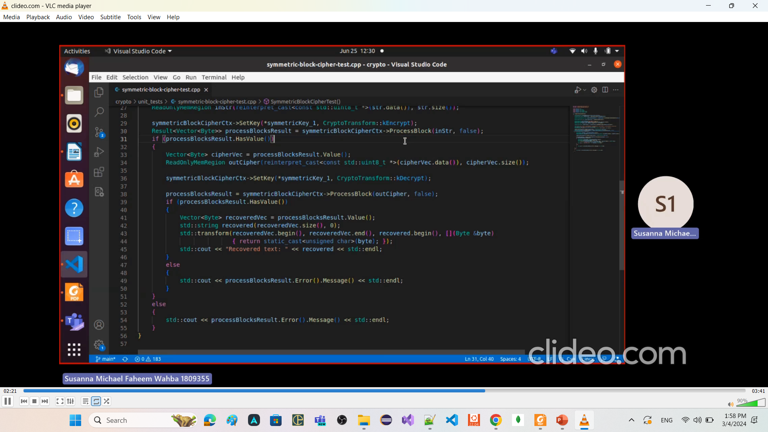
Symmetric Encryption and decryption

Slide 38
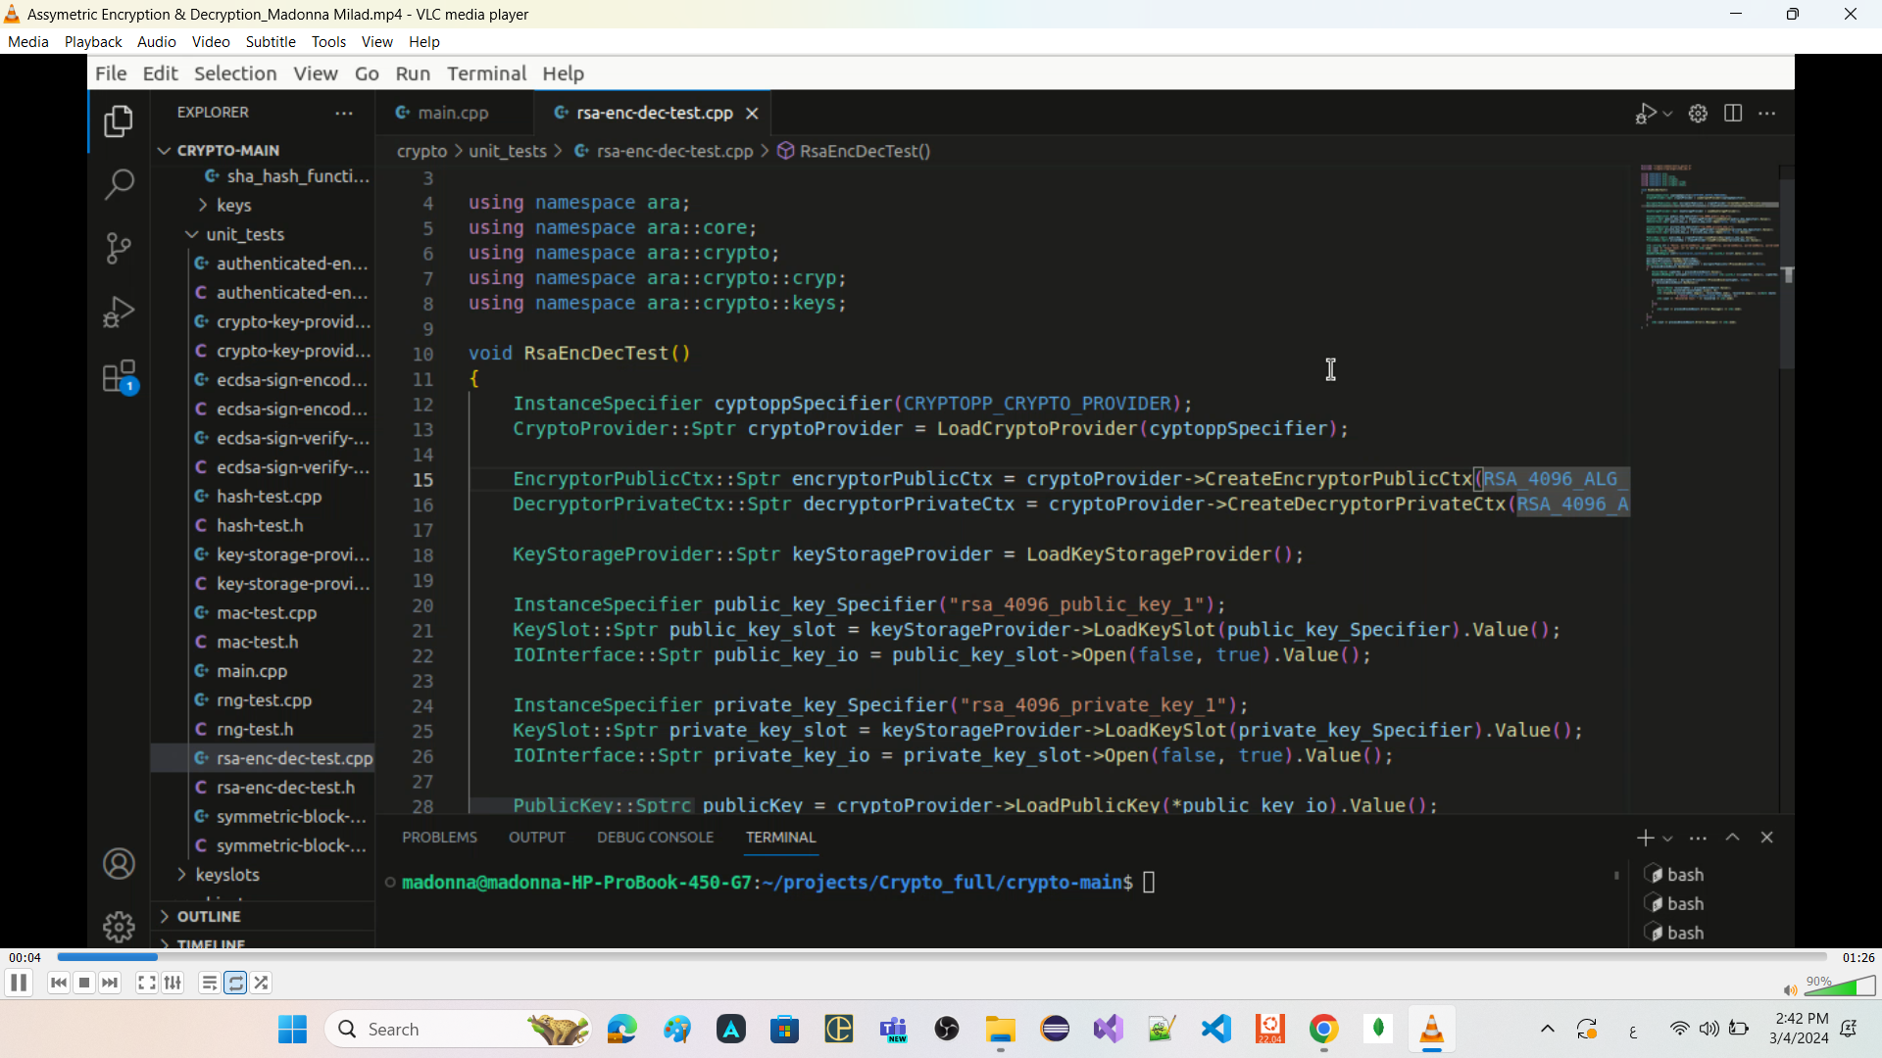
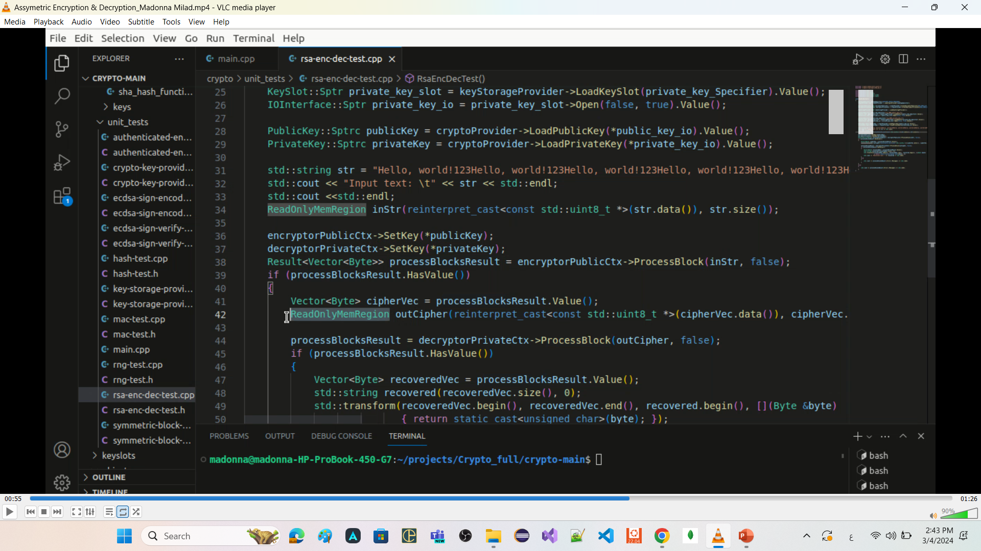
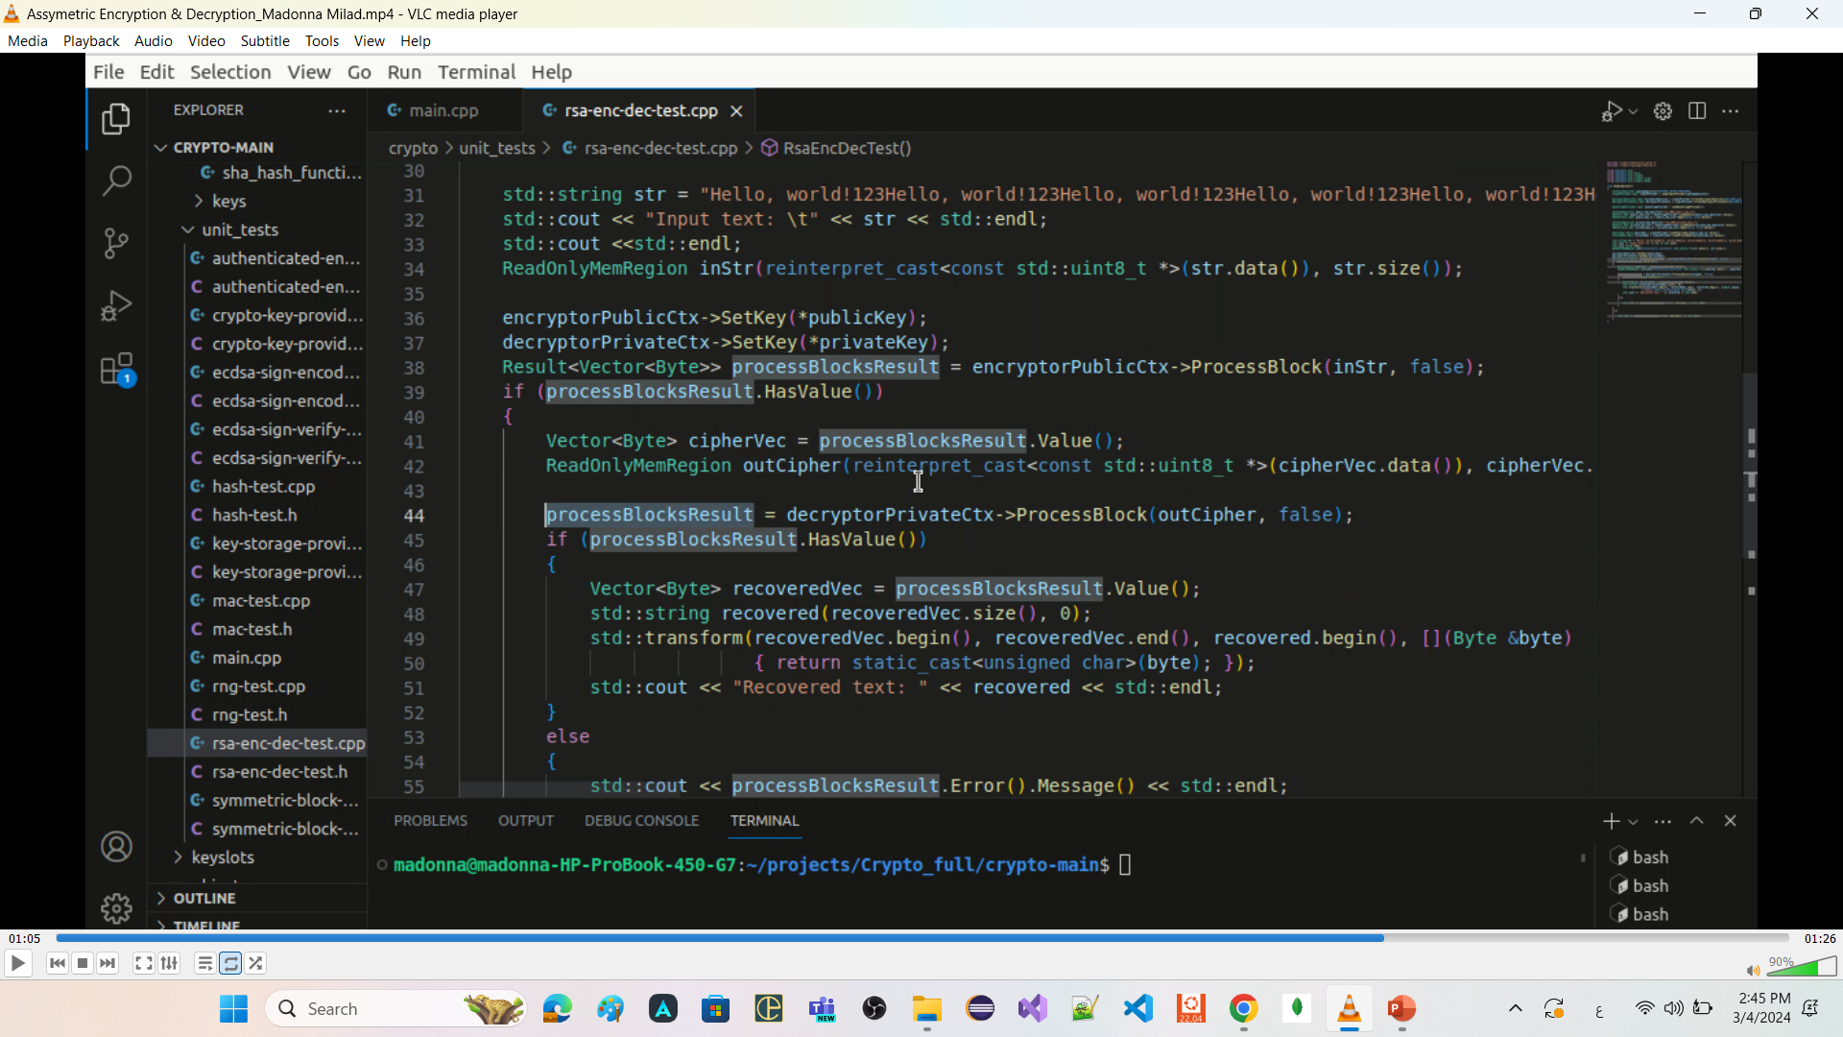
Asymmetric Encryption and decryption

Slide 39
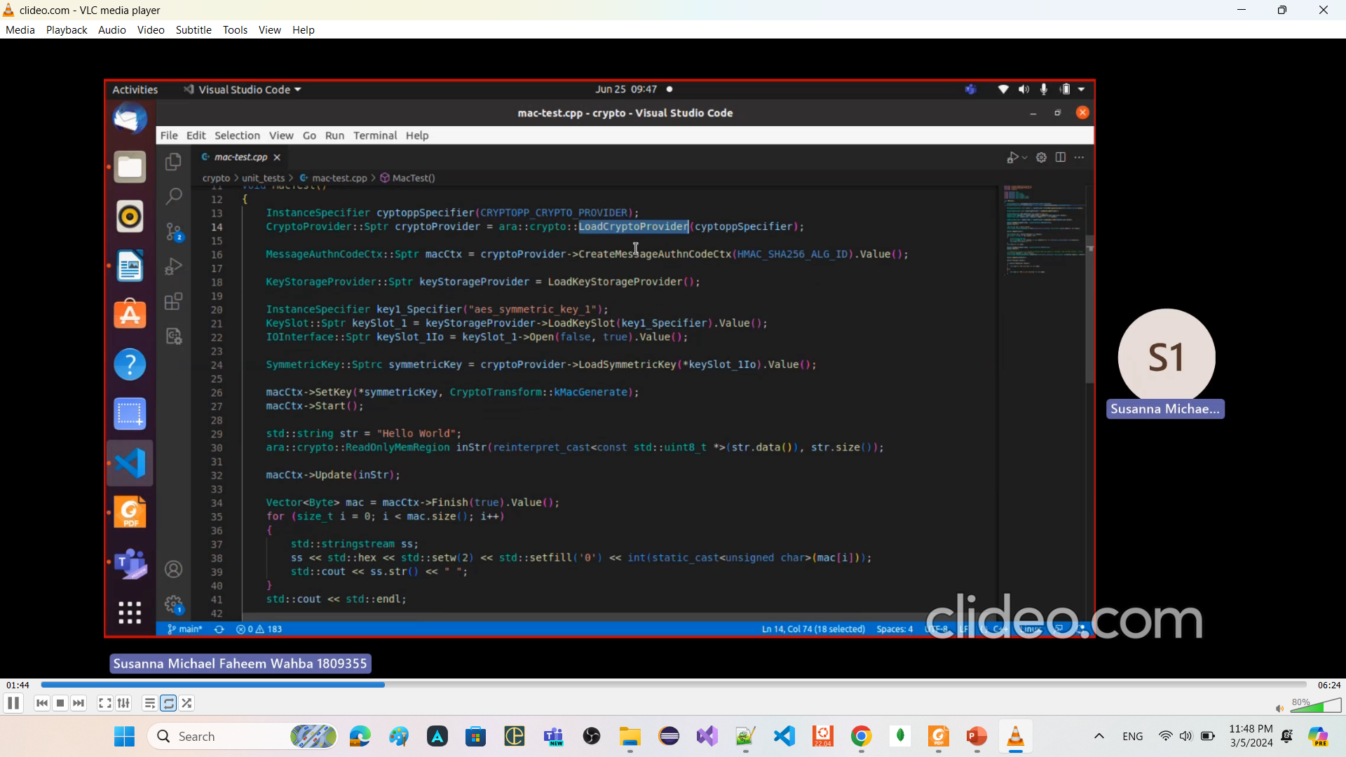
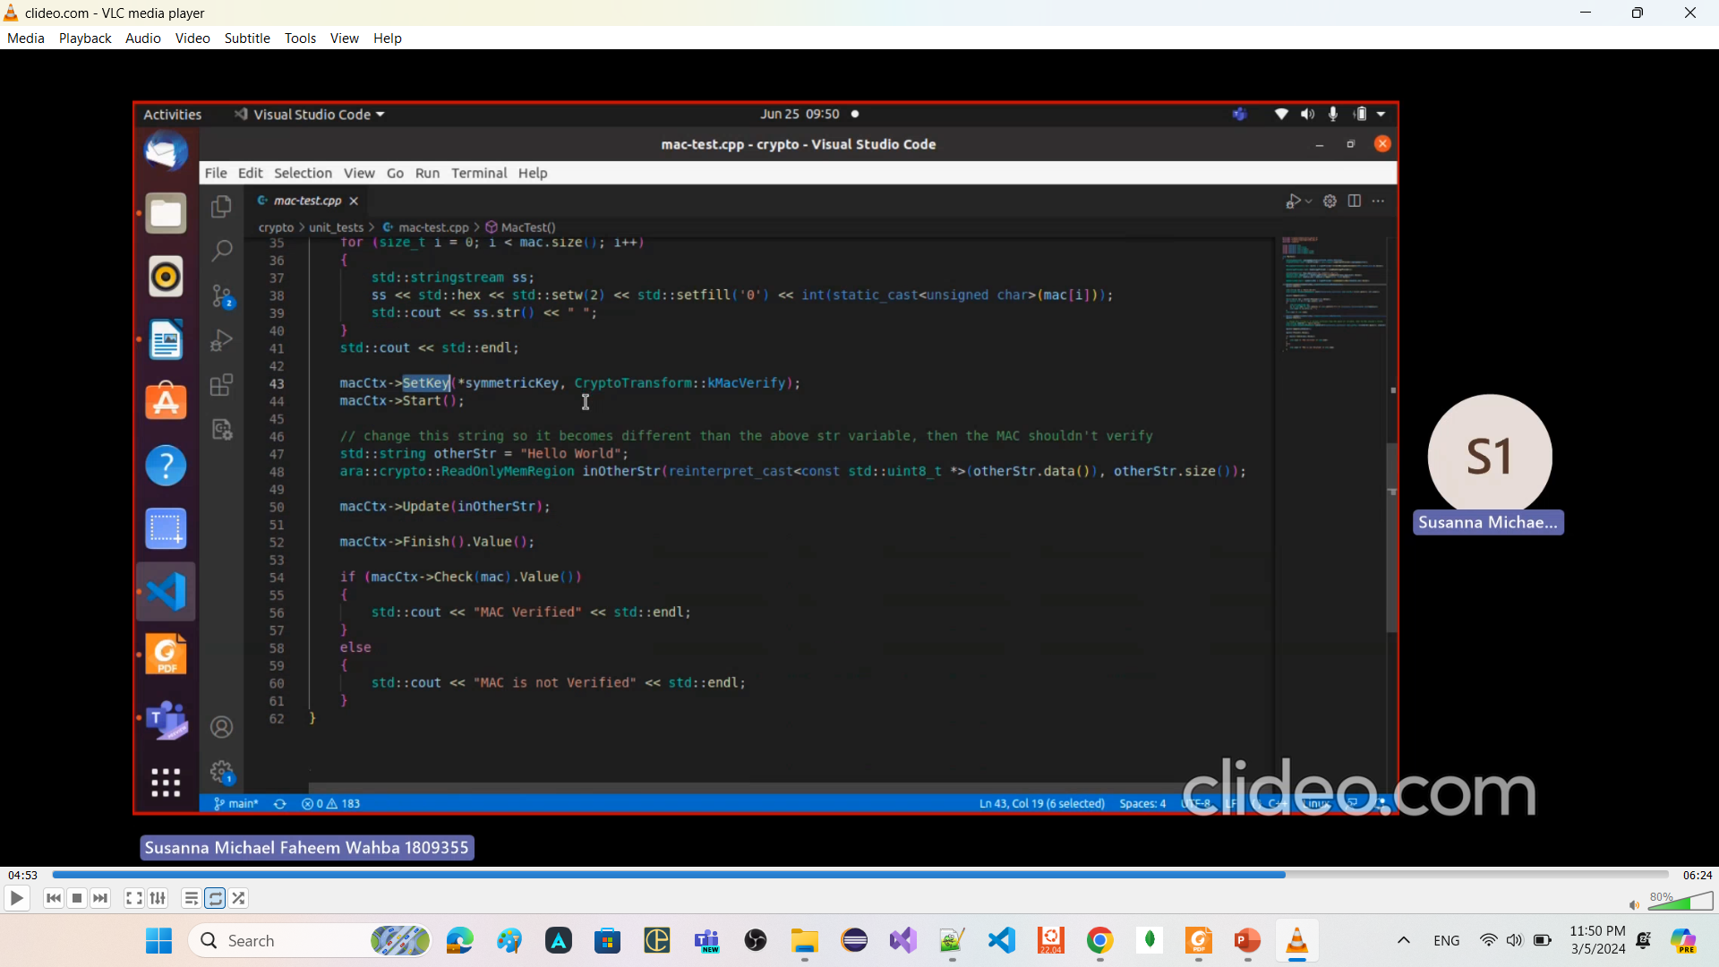
Message authentication
Using HMAC_SHA256

Slide 42
std::span
a C++20 class template that provides a view over a contiguous sequence of elements.
"view" refers to a lightweight object that provides a way to look at or access elements of a data structure
without owning the data itself.
without making a copy of the data
particularly useful for passing
array or sub-array
std::array or sub-std::array
std::vector or sub-std::vector
to functions without the need for copying.

